Slide 1

OCT 11, 2019
HAPPINESS TRACKERS
By Jose Roncal & Nicole Brands

Slide 2


HAPPINESS IS INCREASINGLY CONSIDERED AN IMPORTANT AND USEFUL WAY TO GUIDE PUBLIC POLICY AND MEASURE ITS EFFECTIVENESS.
THE REPORT INCORPORATES ANALYSIS BY EXPERTS IN ECONOMICS, NEUROSCIENCE AND STATISTICS, AND SHOWS HOW MEASUREMENTS OF WELL-BEING CAN BE USED TO EVALUATE A COUNTRY’S PROGRESS.
WHY HAPPINESS INDEX?

Slide 3

CAN WE LEARN FROM EACH OTHER TO MAKE IMPROVEMENTS FOR THE OVERALL SATISFACTION OF THE WORLD?
WHICH COUNTRIES ARE THE MOST IDEAL LOCATIONS FOR WELL-BEING AND PROSPERITY FOR A SUCCESSFUL LIFE?
ARE THERE CERTAIN FACTORS THAT POSITIVELY OR NEGATIVELY IMPACT THE LEVEL OF HAPPINESS OF PEOPLE?
QUESTIONS TO BE ANSWERED
KEY DISCUSSION POINTS

Slide 4






WHERE DID WE GET OUR DATA?
WORLD HAPPINESS REPORT
LIFE EXPECTANCY REPORT
ECONOMIC FREEDOM INDEX
KAGGLE

Slide 5

CODING APPROACH & DATA CLEANING
SET UP &
EXTRACT
DATABASE
TRANSFORM
RENAME COLUMNS.
SORT VALUE.
ROUND DECIMALS.
DROP NULL’S.
MERGE DF’S.
CREATE ENGINE/TABLE FOR SQLITE FILE TO QUERY DATABASE FOR VISUAL ANALYSIS.
IMPORT DEPENDENCIES.
DECLARE CSV’S.
READ INTO PANDAS DATA FRAMES.

Slide 6

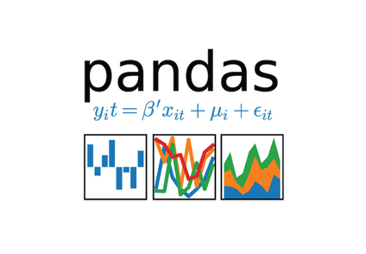

VISUALIZATIONS
MAP
GRAPHS
WE'VE CREATED A MAP THAT SHOWS DIFFERENT HAPPINESS INDEXES OF COUNTRIES AROUND THE WORLD. THIS MAP WAS CREATED WITH HIGHMAPS WHICH IS A JAVASCRIPT LIBRARY.
WE'VE ALSO CREATED MULTIPLE GRAPHS TO ANALYZE DIFFERENT TRENDS AND TO GET A BETTER UNDERSTANDING IN HOW VARIABLES SUCH AS ECONOMIC FREEDOM, GDP, LIFE EXPECTANCY AND COUNTRY STATUS IMPACT HAPPINESS INDEX.

Slide 7
LET US SHOW YOU ...
OUR WEBSITE!

